Slide 1

@somkiat

Slide 2
Node.js goal
Provide easy way to build scalable network application

Slide 3
Node.js not
Another Web framework
For beginner
Multi-thread

Slide 4
Node.js is
Server side JavaScript
Fun !!!

Slide 5
Node.js why
Non Blocking I/O
V8 Javascript Engine
Single Thread with Event Loop
40,025 modules
Windows, Linux, Mac
1 Language for Frontend and Backend
Active community

Slide 6
Node.js for
Web application
Websocket server
Ad server
Proxy server
Streaming server
Fast file upload client
Any Real-time data apps
Anything with high I/O

Slide 7









Who use Node.js
http://nodejs.org/industry/

Slide 8
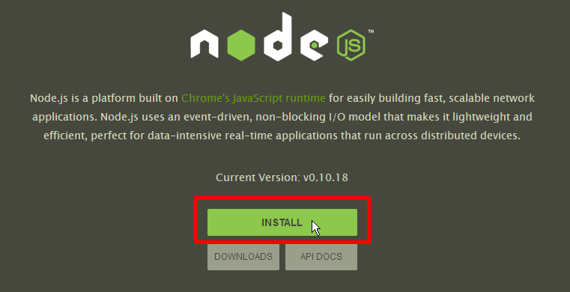
Node.js installation
Download package from Nodejs.org

Slide 9
Demo :: Hello World
Create file hello.js
console.log( “Hello World” );
Run with Node
$node hello.js
>> Hello World

Slide 10
Blocking vs Non-Blocking
Topic :: Read data from file and show data

Slide 11
Blocking
Read data from file
Show data
Do other tasks
var data = fs.readFileSync( “test.txt” );
console.log( data );
console.log( “Do other tasks” );
http://nodejs.org/api/fs.html

Slide 12
Non-Blocking
Callback
Read data from file
When read data completed, show data
Do other tasks
fs.readFile( “test.txt”, function( err, data ) {
console.log(data);
});
console.log(“Do other tasks”);

Slide 13
Callback syntax
fs.readFile( “test.txt”, function( err, data ) {
console.log(data);
});
fs.readFile( “test.txt”, callback )
var callback = function( err, data ) {
console.log(data);
}
As same as

Slide 14
Blocking vs Non-Blocking
var callback = function(err, data) {
console.log(data);
}
fs.readFile("test.txt", callback);
fs.readFile("test2.txt", callback);

Slide 15
Blocking vs Non-Blocking

Slide 16
Recommended modules
Async
https://github.com/caolan/async
Step
https://github.com/creationix/step

Slide 17
Demo :: Basic HTTP
#hello_server_01.js
var http = require('http');
http.createServer( function (req, res) { res.writeHead(200, {'Content-Type': 'text/plain'}); res.end('Hello World\n'); }).listen(1337, '127.0.0.1');
console.log('Server running at http://127.0.0.1:1337');

Slide 18
Demo :: Basic HTTP
$node hello_server_01.js
>Server running at http://127.0.0.1:1337/
Check result from browser http://127.0.0.1:1337

Slide 19
Demo :: Basic HTTP ( Refactor )
var http = require('http');
var server = http.createServer(function (req, res) { res.writeHead(200, {'Content-Type': 'text/plain'}); res.end('Hello World\n'); });
server.listen(1337, ‘127.0.0.1’);
console.log('Server running at http://127.0.0.1:1337/');

Slide 20
Event Loop ?
var http = require('http');
var server = http.createServer(function (req, res) { ….
});
server.listen(1337, ‘127.0.0.1’);

Slide 21
Event Loop ?
var http = require('http');
var server = http.createServer(function (req, res) { ….
});
server.listen(1337, ‘127.0.0.1’);
Start Event Loop

Slide 22
Event Loop ?
var http = require('http');
var server = http.createServer(function (req, res) { ….
});
server.listen(1337, ‘127.0.0.1’);
Run callback
Checking Event
Known Event
Request

Slide 23
Event Loop
Event
Checking Event
Known Event
Request
Request
Close
Connection

Slide 24
Handle Event
var http = require('http');
var server = http.createServer();
server.on('request', function(req, res){
res.write('Got request\n');
res.end();
});
server.listen(1337, ‘127.0.0.1’);
http://nodejs.org/api/http.html

Slide 25
Demo :: Echo server
var server = http.createServer( function(req, res) {
res.writeHead(200);
req.on('data', function(data) {
res.write(data);
});
req.on('end', function(){
res.end();
});
});

Slide 26
Demo :: Echo server
$curl -d "somkiat" http://localhost:1337

Slide 27
Demo :: Echo server
var server = http.createServer( function(req, res) {
res.writeHead(200);
req.on('data', function(data) {
res.write(data);
});
req.on('end', function(){
res.end();
});
});
Pipe data from request to response

Slide 28
Demo :: Echo server + Pipe
var server = http.createServer( function(req, res) {
res.writeHead(200);
req.pipe(res);
});

Slide 29
Demo :: Upload file
http.createServer(function(req, res) {
var newFile = fs.createWriteStream("uploaded.txt");
req.pipe(newFile);
req.on('end', function() {
res.end('uploaded!');
});
}).listen(1337);
Create file on server and pipe data to file

Slide 30
Demo :: Upload file
http.createServer(function(req, res) {
var newFile = fs.createWriteStream("uploaded.txt");
req.pipe(newFile);
req.on('end', function() {
res.end('uploaded!');
});
}).listen(1337);
Handle end event on request

Slide 31
Demo :: Upload file
$curl --upload-file test.txt http://localhost:1337

Slide 32
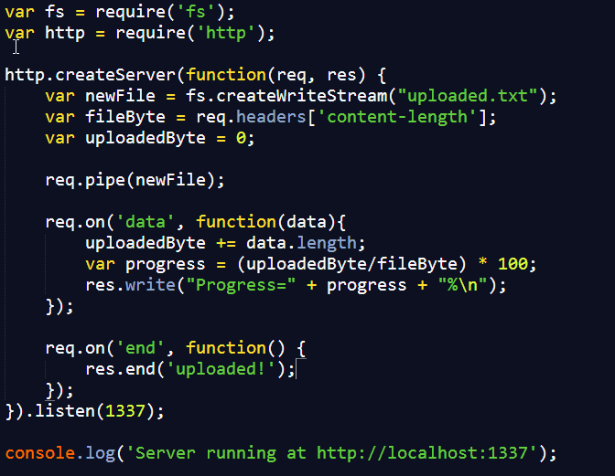
Demo :: Upload file with progress

Slide 33
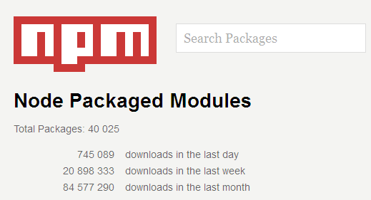
Node.js Modules
https://npmjs.org/
# of modules = 40,025

Slide 34
Install module
$npm install <module name>

Slide 35
Using module
var http = require(‘http’);
var fs = require(‘fs’);
var express = require(‘express’);

Slide 36
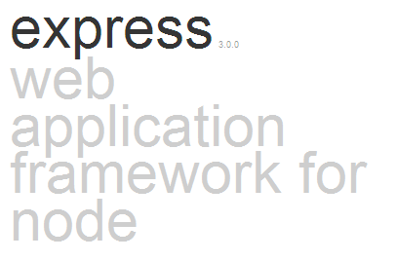
Working with Express
http://expressjs.com

Slide 37
Working with Express
Inspire from Sinatra
Fast
Flexible
Simple

Slide 38
Installation express
$npm install express

Slide 39
Demo :: Express
var express = require('express');
var app = express();
app.get('/', function (req, res) {
res.setHeader('Content-Type', 'text/plain');
res.end('Hello, world!');
});
app.listen(1337);
console.log('Listening on port 1337');

Slide 40
Demo :: Manage package
$npm init
$npm info express version

Slide 41
Demo :: package.json
{
"name": "hello-world",
"description": "hello world test app",
"version": "0.0.1",
"private": true,
"dependencies": {
"express": "3.3.x"
}
}

Slide 42
Demo :: Install and run
$npm install
$node http_express.js

Slide 43
Develop REST API
REST = REpresentational State Transfer
Not new technology
Architectural style for client-server
http://en.wikipedia.org/wiki/Representational_state_transfer

Slide 44
Goals of REST
General interface
Scalability of component interface
Reduce latency
Encapsulate legacy system

Slide 45

SOA is DEAD!!

Slide 46
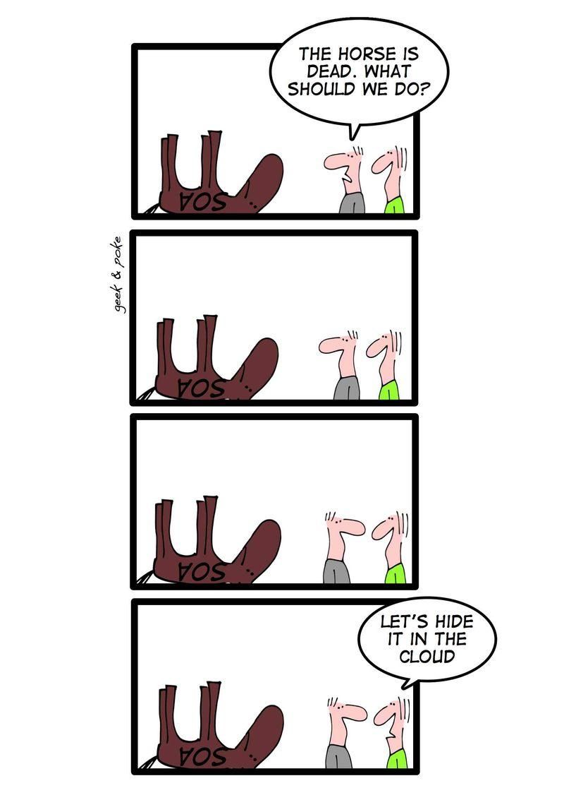
SOA is DEAD !!!
http://www.zdnet.com/blog/service-oriented/you-cant-beat-the-dead-soa-horse/3708

Slide 47
HTTP Method
GET
POST
PUT
DELETE

Slide 48
HTTP Method with CRUD
POST => Create
GET => Read
PUT => Update
DELETE => Delete

Slide 49
Demo :: REST with JSON
app.get('/', function (req, res) {
res.json(persons);
});
app.post('/', function (req, res) {
res.json(persons);
});

Slide 50
Demo :: REST with JSON
app.put('/', function (req, res) {
res.json(persons);
});
app.delete('/', function (req, res) {
res.json(persons);
});

Slide 51
Demo :: Refactoring
app.get('/', callback);
var callback = function getData(req, res) {
res.json(persons);
}

Slide 52
Working with Persistence
MySQL
MongoDB
Redis

Slide 53
Working with Persistence
MySQL
REST API
Person service
Redis
MongoDB

Slide 54
REST API
Method | URL | Action
GET | / | Get all person
GET | /person/3 | Get person by id=3
POST | /person | Add new person
PUT | /person | Update person by id
DELETE | /person/3 | Delete person by id=3

Slide 55
Demo :: REST API
var express = require('express');
var service_person = require('./service_person')
var app = express();
app.get('/', service_person.all);
app.get('/person/:id', service_person.one);
app.post('/person', service_person.insert);
app.put('/person', service_person.update);
app.get('/person/:id', service_person.delete);
app.listen(process.env.PORT || 1337);

Slide 56
Working with MySQL
RDBMS
Module => see in npmjs.org ( a lot !!!! )
"mysql": "2.0.0-alpha9"

Slide 57
Design Table
Table name = person
Column
id
name
gender

Slide 58
Demo :: Connect to MySQL
var mysql = require('mysql');
var connection = mysql.createConnection(
{
host: <db server>,
user: <username>,
password: <password>,
database: <database name>
}
);

Slide 59
Demo :: Retrieve all data
connection.query('select * from person',
function(err, rows, fields) {
res.contentType('application/json');
res.write(JSON.stringify(rows));
res.end();
}
);

Slide 60
Demo :: Retrieve data with criteria
var sql = 'select * from person where id=?';
connection.query( sql, [id],
function(err, rows, fields) {
res.contentType('application/json');
res.write(JSON.stringify(rows));
res.end();
}
);

Slide 61
Demo :: Create new data
var sql = 'insert into person (name, gender) values (?, ?)
';
connection.query( sql, [name, gender],
function(err, rows, fields) {
res.json(true);
}
);

Slide 62
Working with MongoDB
NoSQL
Document-oriented stoarage
Keep data in BSON format
http://www.mongodb.org/
Module => see in npmjs.org ( a lot !!!! )
"redis": "0.8.4"
http://en.wikipedia.org/wiki/BSON

Slide 63
Start MongoDB server
$mongod.exe --dbpath /some/data/path

Slide 64
Demo :: Connect to MongoDB
var mongo = require('mongodb');
var Server = mongo.Server,
var server = new Server(
'localhost',
27017,
{auto_reconnect: true}
);
db = new Db('persons', server);

Slide 65
Demo :: Connect to MongoDB
db.open(function(err, db) {
if(!err) {
db.collection('persons', {strict:true},
function(err, collection) {
if (err) {
populateDB();
}
});
}

Slide 66
Demo :: Retrieve all data
exports.all = function(req, res){
db.collection('persons', function(err, collection) {
collection.find().toArray(function(err, persons) {
res.send(persons);
});
});
};

Slide 67
Demo :: Retrieve data by id
exports.one = function(req, res){
var personId = req.params.id;
db.collection('persons', function(err, collection) {
collection.findOne(
{'_id':new BSON.ObjectID(personId)},
function(err, person) {
res.send(person);
});
});
};

Slide 68
Demo :: Create new data
exports.insert = function(req, res){
db.collection('persons', function(err, collection) {
collection.insert( person, {safe:true},
function(err, result) {
});
});
});

Slide 69
Demo :: Update data
exports.insert = function(req, res){
db.collection('persons', function(err, collection) {
collection.update( {
'_id':new BSON.ObjectID( personId )},
updatePerson,
{safe:true},
function(err, result) {
});
});
});

Slide 70
Demo :: Delete data by id
exports.insert = function(req, res){
db.collection('persons', function(err, collection) {
collection.remove( {
'_id':new BSON.ObjectID( personId )},
{safe:true},
function(err, result) {
});
});
});

Slide 71
Design Document
Collection = persons
Document structure
name
gender

Slide 72
Working with Redis
NoSQL
Key-value data store
http://redis.io
Module => see in npmjs.org ( a lot !!!! )
"redis": "0.8.4"

Slide 73
Install Redis
Download from http://redis.io/
For Windows OS
https://github.com/dmajkic/redis/downloads

Slide 74
Start Redis server
$redis-server
Let’s fun with Redis
$redis-cli

Slide 75
Design Key-Value
Key = person_list
type = List
value = id
Key = id
type = Hash
id = <id>
name = <name>
gender = <gender>

Slide 76
Demo :: Connect to Redis
var redis = require('redis');
var connection = redis.createClient(
{
host: 'localhost',
port: '6379'
}
);

Slide 77
Favorite Modules
express
underscore
request
async
mysql
Find more in npmjs.org

Slide 78
Another project like Node.js
Vert.x => Polygot programming
Akka => Scala and Java
Tornado => Python
Libevent => C
EventMachine => Ruby

Slide 79


Book

Slide 80
Resources
Sourcecode for demo https://github.com/up1/demo_nodejs
https://npmjs.org
http://nodejs.org/
http://callbackhell.com/
http://nodeframework.com/

Slide 81
Q/A

